Slide 1
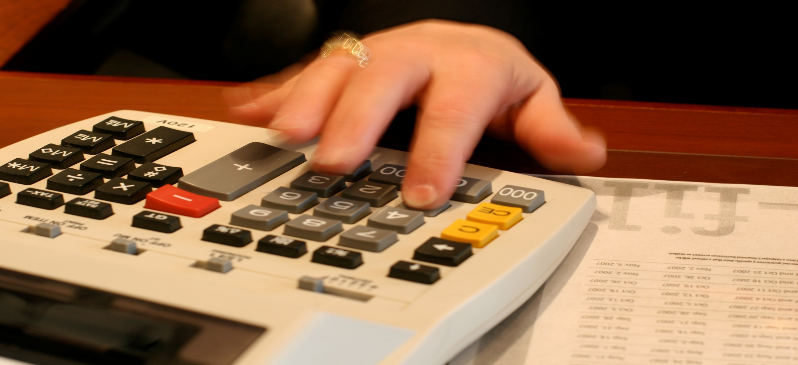
Learn More About HLM
404-836-1120 HLMOneStop.com

Slide 2
Learn More About HLM
Accounting
Business Consulting
Financial Planning
Tax Planning & Preparation

Slide 3
Learn More About HLM

Slide 4
Learn More About HLM
Budgeting
Business Valuations
Financial Analysis
Payroll Preparation
HLM is ready to assist with all your tax needs:
Corporate Tax
Estate and Fiduciary Tax
Expat Tax
Gift Tax
Individual Tax

Slide 5
Learn More About HLM

Slide 6
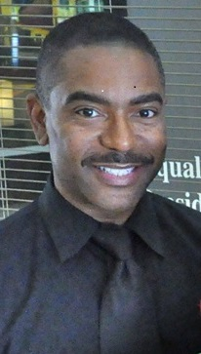
Learn More About HLM Financial Services
Lawrence Waller II, CFS
President
HLM Financial Services

Slide 7
Learn More About HLM
Located in the heart of downtown Decatur at:
160 Clairemont Avenue, Ste 360
Decatur, GA 30030

